Slide 1
FLIGHT PRICE PREDICTION
Project Presentation
Submitted By | Ankit Dadarwala | Data Science Intern at Flip Robo Technologies

Slide 2

Introduction
Problem Statement:
The airline industry is considered as one of the most sophisticated industry in using complex pricing strategies. Nowadays, ticket prices can vary dynamically and significantly for the same flight, even for nearby seats. The ticket price of a specific flight can change up to 7 times a day. Customers are seeking to get the lowest price for their ticket, while airline companies are trying to keep their overall revenue as high as possible and maximize their profit. However, mismatches between available seats and passenger demand usually leads to either the customer paying more or the airlines company losing revenue. Airlines companies are generally equipped with advanced tools and capabilities that enable them to control the pricing process. However, customers are also becoming more strategic with the development of various online tools to compare prices across various airline companies. In addition, competition between airlines makes the task of determining optimal pricing is hard for everyone

Slide 3
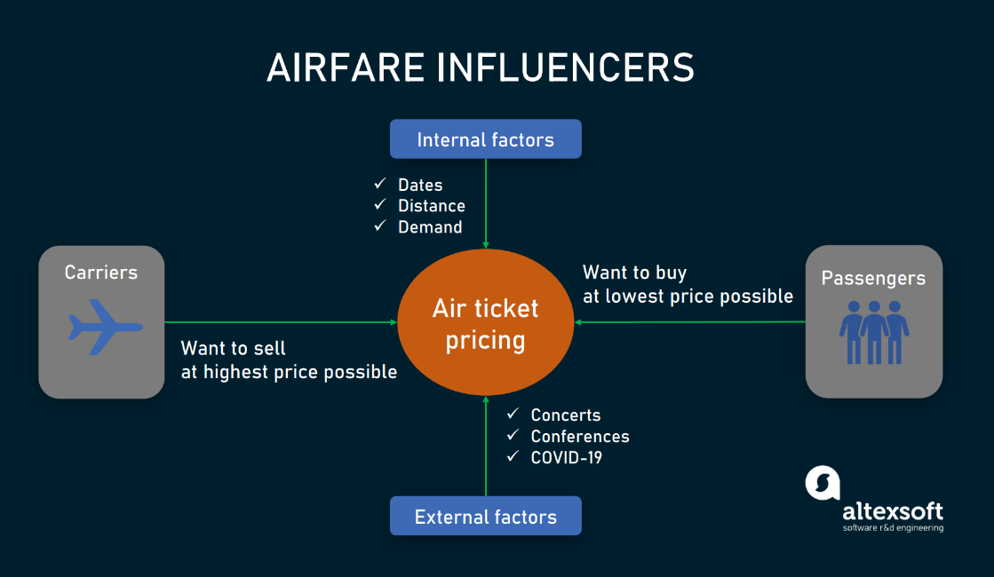
Introduction
Anyone who has booked a flight ticket knows how unexpectedly the prices vary. The cheapest available ticket on a given flight gets more and less expensive over time. This usually happens as an attempt to maximize revenue based on -
Time of purchase patterns (making sure last-minute purchases are expensive)
Keeping the flight as full as they want it (raising prices on a flight which is filling up in order to reduce sales and hold back inventory for those expensive last-minute expensive purchases)

Slide 4

Exercise
Build a model which can be used to predict in terms of a probability for each car price transaction,.
In this case, target column has continues values so we used regression based models.

Slide 5
Points to remember
There are no duplicates values in the dataset.
There are NO null values in transmission column.
Data take by selenium web scraping tool from Yatra.com
Size of the dataset is 1765 rows and 9 columns with target
We have scrap like airlines names, departure time, arrival time, source city, destination city, no. of stops, duration hours and price as target.

Slide 6
Project Goals
Analytical Problem Framing
Exploratory Data Analysis (EDA)
Visualizations
Data Pre-Processing on train and test datasets
Model/s Development and Evaluation
Performing hyper parameter tuning, saving the best model and predicting the target
Conclusion and future work discussion

Slide 7
column Description
name => airlines name
deprt => depature time
arrvt => arrival time
sorct => source city
dest => destination city
stops => No.of stops
duration => total duration traveling time
price => traveling charges of airlines

Slide 8
Exploratory Data Analysis
First scrap data from the Yatra.com and make data frame than save as csv format file.
I have imported the necessary libraries and loaded the entire dataset in our Jupyter Notebook and renamed the project file from untitled.
Then I checked the shape of our dataset and found that we have a total of 1765 rows and 9 different columns.
We have No null values or missing values present in our dataset.
By checking the data types I came to know that our data set consists of columns have only object data type so convert into their respective types of data.
Shape : 1765 rows and 09 columns
No null values present
No Duplicate record found
Datatypes of object are in dataset

Slide 9
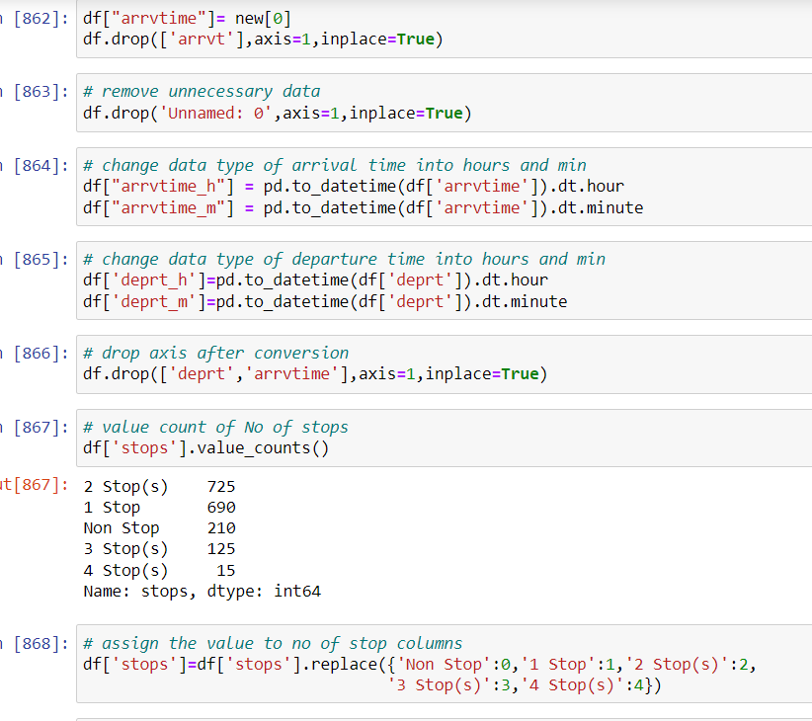
Data Preprocessing
As a first step I have imported required libraries and I have imported the dataset which was scrap and save in csv format.
Then I did all the analysis like data types, checking shape, unique, value counts, info, duplicates value null values etc.
In that I found that all are objective data types so have change data types in that have some date-time format also int as well float data types.
While checking for null values I found no null values in the dataset.
I have also dropped Unnamed:0, column as I found they are useless

Slide 10
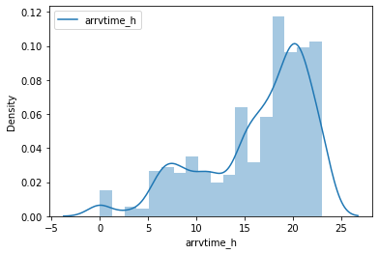
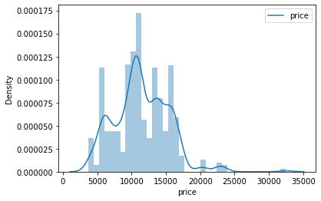
Describe
Here we see a statistical representation of the all the numeric data columns.
In that have skewness so treat them with log method

Slide 11
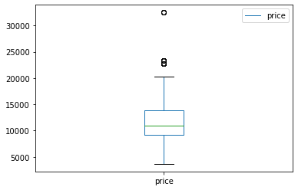
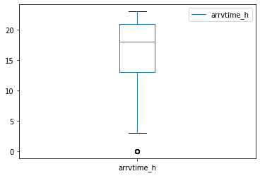
Describe
Here we see a statistical representation of the all the numeric data columns.
In that have some outliers so treat them with Z-Score methods

Slide 12
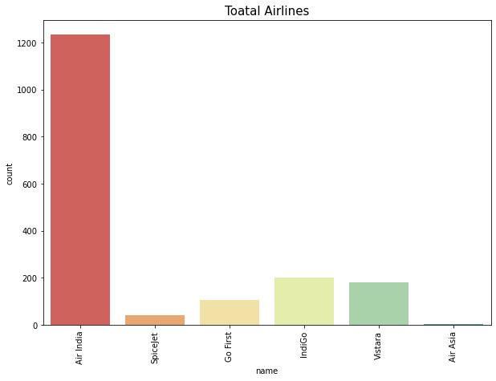
Bivariate Analysis
Total Airlines
With the help of count Plot we are able to see the success and failure label data for the columns basically the feature data.

Slide 13
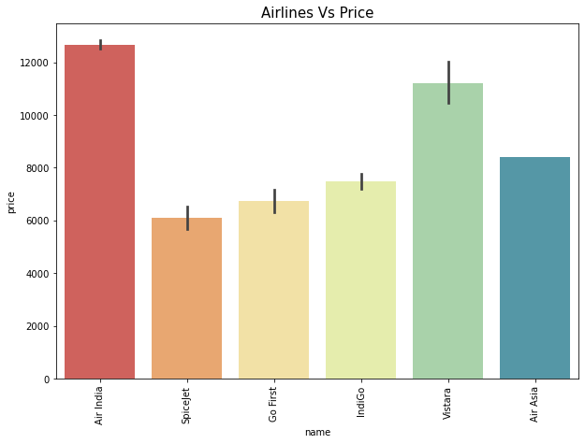
Airlines Vs. Price

Slide 14
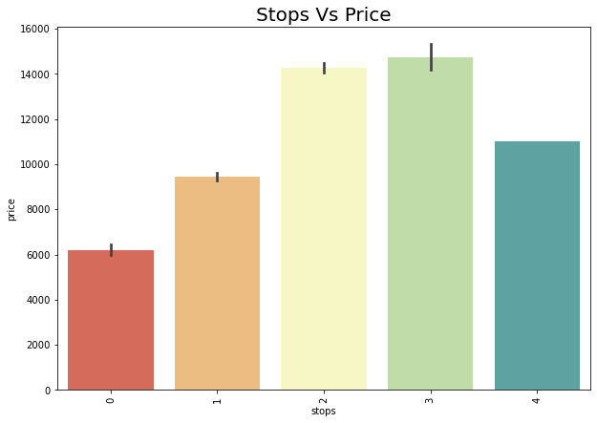
Price accordance with No. of Stops

Slide 15
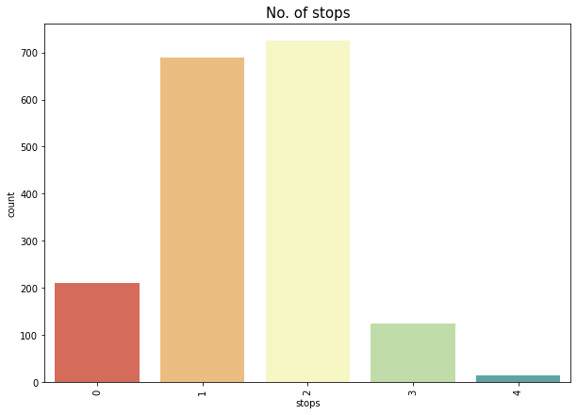
Frequently Np. Of Stops in Airlines

Slide 16
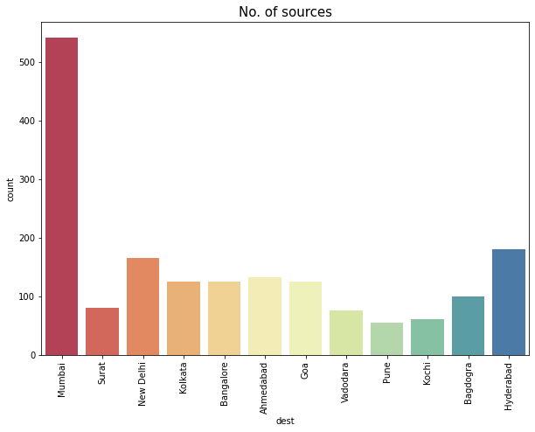
Frequency of Destination cities

Slide 17
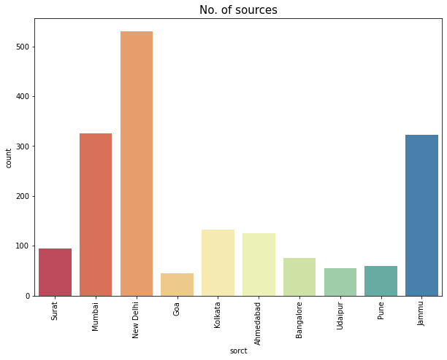
Frequency of Destination cities

Slide 18
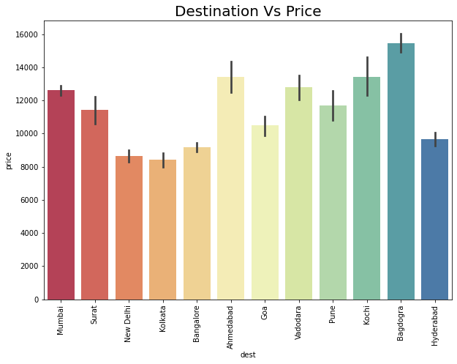
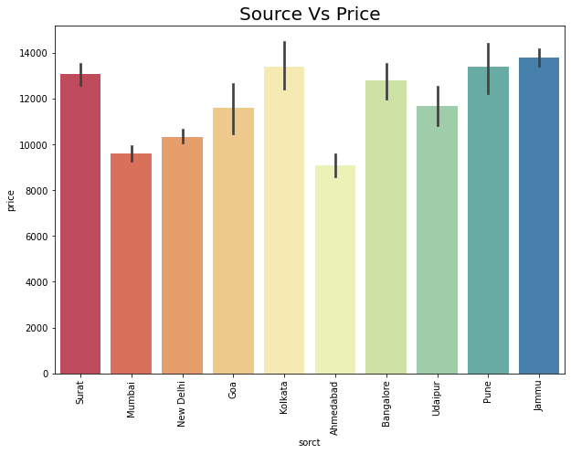
PRICE Accordance with Destination and Source

Slide 19
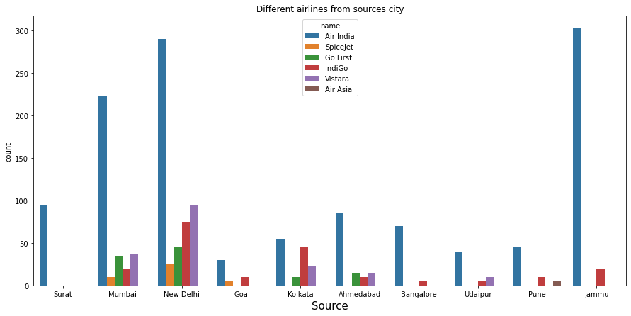
Airlines from source cities

Slide 20
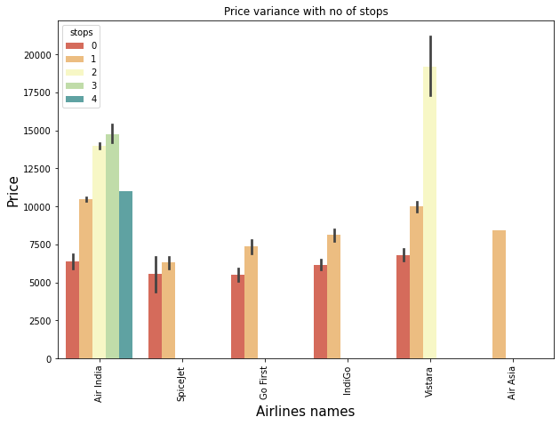
PRICE Variance with No. of stops

Slide 21
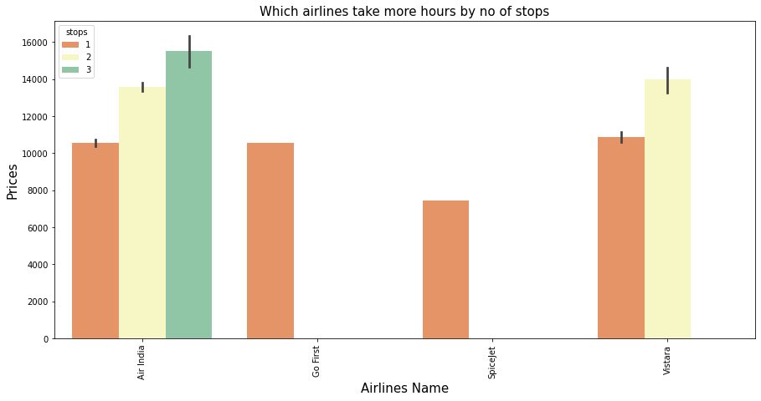
Which Airlines take More hours

Slide 22
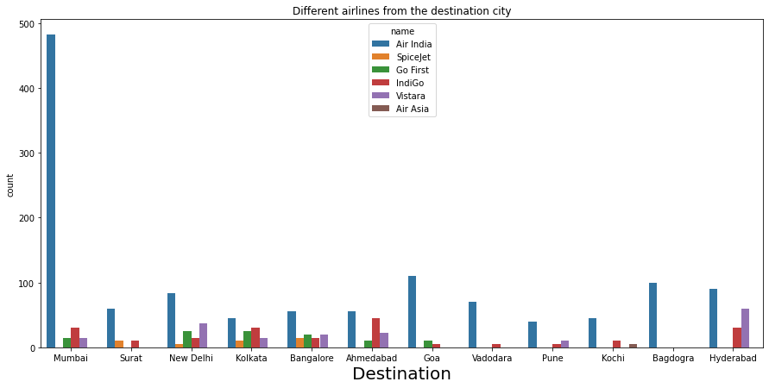
Different airlines from destination cities

Slide 23
Different airlines from destination cities
Airlines Name | Source Cities | Destination Cities | Min Price | Max Price
Vistara | Kolkata | Ahmedabad | 11363 | 32477
Air India | New Delhi | Bagdogra | 13890 | 23338
 | Jammu | Mumbai | 9215 | 20229
 | Pune | Kochi | 11610 | 17403
 | Surat | Mumbai | 10674 | 16851
 | Goa | Surat | 11683 | 16237
 | Mumbai | Surat | 10668 | 16233
 | Bangalore | Vadodara | 9277 | 16099
 | Kolkata | Ahmedabad | 13695 | 15939
Vistara | New Delhi | Hyderabad | 5955 | 15498
Air India | Udaipur | Pune | 9834 | 15399
IndiGo | Goa | Surat | 5316 | 13293
 | Kolkata | Ahmedabad | 7959 | 13125
Air India | Mumbai | Goa | 4263 | 13086
 | New Delhi | Kolkata | 10081 | 12150
Vistara | Mumbai | New Delhi | 6048 | 12138
Air India | Mumbai | New Delhi | 5943 | 12138
 | New Delhi | Hyderabad | 5955 | 12071
 |  | Bangalore | 7425 | 10680
Vistara | New Delhi | Bangalore | 7425 | 10680
 | Ahmedabad | Mumbai | 10627 | 10627
Air India | Ahmedabad | Mumbai | 4222 | 10627
Go First | New Delhi | Bangalore | 7424 | 10575
 |  | Kolkata | 5954 | 10550
IndiGo | Jammu | Mumbai | 10412 | 10412
 | New Delhi | Bangalore | 7425 | 10365
 |  | Hyderabad | 5955 | 9315
Vistara | New Delhi | Kolkata | 5955 | 9000
 | Udaipur | Pune | 8457 | 8993
Air Asia | Pune | Kochi | 8399 | 8399
Go First | Kolkata | Ahmedabad | 7958 | 7959
SpiceJet | New Delhi | Bangalore | 7425 | 7425
IndiGo | New Delhi | Kolkata | 5955 | 7420
 | Mumbai | New Delhi | 5942 | 6363
SpiceJet | New Delhi | Kolkata | 6270 | 6270
IndiGo | Bangalore | Vadodara | 6018 | 6018
SpiceJet | Mumbai | New Delhi | 5943 | 5943
Go First | Mumbai | New Delhi | 5942 | 5942
IndiGo | Udaipur | Pune | 5668 | 5668
 | Pune | Kochi | 5433 | 5433
 | Ahmedabad | Mumbai | 4431 | 4536
SpiceJet | Goa | Surat | 4475 | 4475
IndiGo | Mumbai | Goa | 4263 | 4263
Go First | Mumbai | Goa | 4262 | 4262
 | Ahmedabad | Mumbai | 4220 | 4220
SpiceJet | Mumbai | Surat | 3664 | 3664

Slide 24
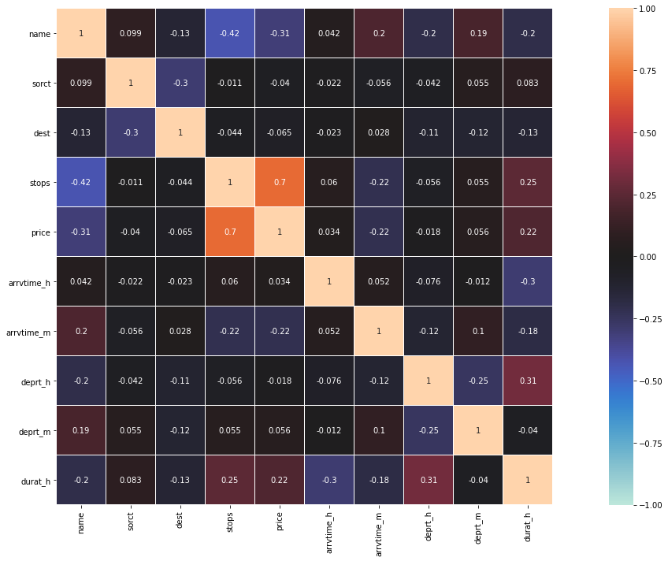
CORRELATION HEAT MAP GRAPH
CORRELATION HEAT MAP
from the correlation map we say that no. of stops, duration hours are most correlated with target price
other are less correlation with it

Slide 25
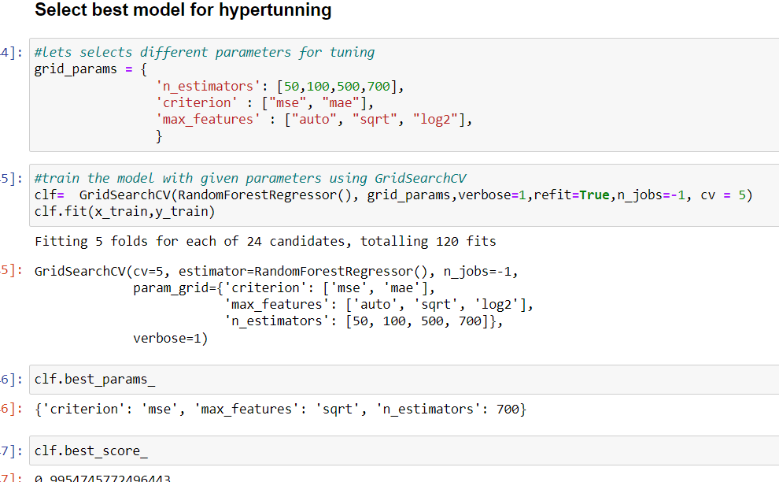
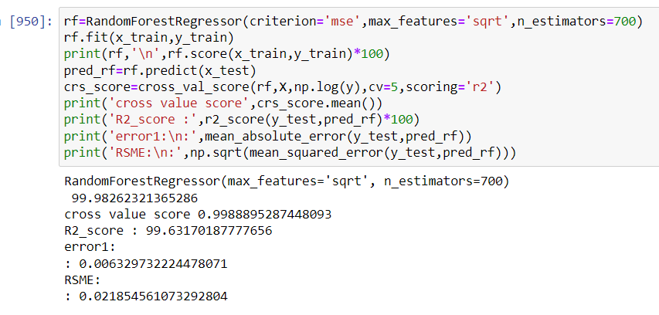
Hyper parameter tuning result

Slide 26
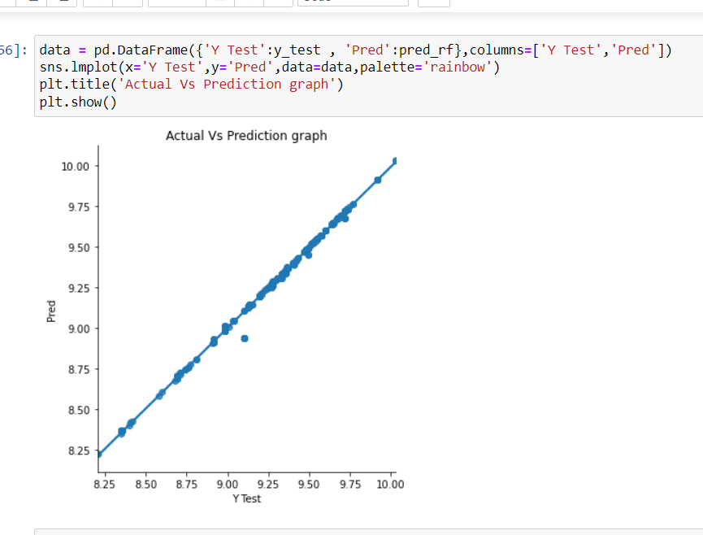
Regression and plot of prediction

Slide 27
Conclusion
Key Findings and Conclusions of the Study
Scraping the flight price data from websites and from different cities are challenging.
Firstly, the datasets were not having duplicates value
But there was no null values in dataset.
And proper plotting for proper type of features will help us to get better insight on the data. I found maximum categorical columns in the dataset so I have chosen bar, count, pie plot to see the relation between target and features.
I notice a skewness in the data so we have chosen proper methods to deal with skewness. If we skewness we may end up with a bad model which has less accuracy.
Then scaling dataset has a good impact like it will help the model not to get biased. Since we have removed outliers and skewness.
We have to use multiple models while building model using dataset as to get the best model out of it.
And we have to use multiple metrics like R2 score, MSE, RMSE and cross value score which will help us to decide the best model.
I found RandomForest Regressor as the best model with 99.63.% R2 score..
At last I have predicted Flight price using saved model. It was good!! that I was able to get the predictions near to actual values.

Slide 28
Limitations of this work and Scope for Future Work
First draw back is the length of the dataset it is small because of scraping data.
Data scrap from the different websites so it can be change at any time so also we have update model with new data at time.
Some algorithms are facing over-fitting problem which may be because of less number of features in our dataset.

Slide 29


